Slide 1



PARULINSTITUTEOF ENGINEERING &TECHNOLOGY
FACULTY OF ENGINEERING & TECHNOLOGY
PARULUNIVERSITY
Subject: Machine Learning
Unit 3 : Supervised Learning – II
Computer Science & Engineering
Dr. Sudhanshu Singh (Associate Prof. PIET-CSE)

Slide 2



Outline
K-NN classifier
Logistic regression
Perceptrons
Single layer Perceptrons
Multi-layer Perceptrons
Support Vector Machines (SVM)
Linear SVM
Non-linear SVM

Slide 3
K-Nearest Neighbor(KNN) Algorithm
K-Nearest Neighbor is one of the simplest Machine Learning algorithms based on Supervised Learning technique.
K-NN algorithm assumes the similarity between the new case/data and available cases and put the new case into the category that is most similar to the available categories.
K-NN algorithm stores all the available data and classifies a new data point based on the similarity. This means when new data appears then it can be easily classified into a well suite category by using K- NN algorithm.
K-NN algorithm can be used for Regression as well as for Classification but mostly it is used for the Classification problems.
K-NN is a non-parametric algorithm, which means it does not make any assumption on underlying data.

Slide 4
K-Nearest Neighbor(KNN) Algorithm
﻿History
It was first described in the early 1950s.
The method is labor intensive when given large training sets.
Gained popularity, when increased computing power became available.
Used widely in area of pattern recognition and statistical estimation.

Slide 5
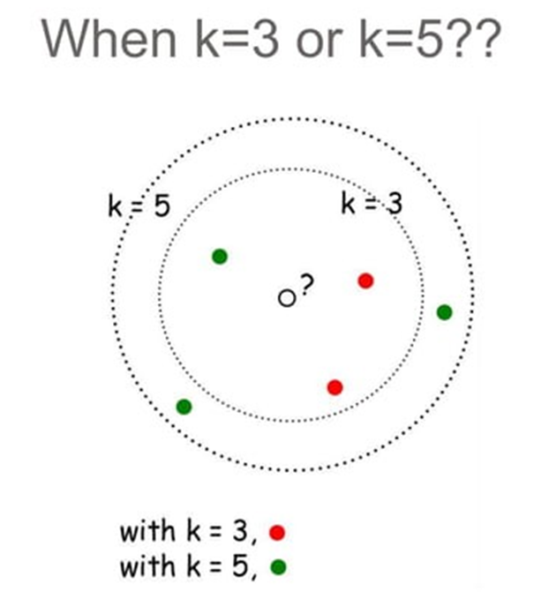
K-Nearest Neighbor(KNN) Example

Slide 6
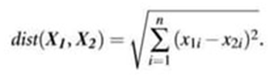
Remarks
﻿Similarity Function Based.
Choose an odd value of k for 2 class problem.
k must not be multiple of number of classes.
Closeness
• The Euclidean distance between two points or tuples, say,

Slide 7
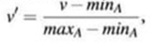
Min-max normalization can be used to transform a value v of a numeric attribute A to v0 in the range [0,1] by computing
﻿What if attributes are categorical??
How can distance be computed for attribute such as colour?
Simple Method: Compare corresponding value of attributes
Other Method: Differential grading

Slide 8
What about missing values ??
If the value of a given attribute A is missing in tuple X1 and/or in tuple X2, we assume the maximum possible difference.
For categorical attributes, we take the difference value to be 1 if either one or both of the corresponding values of A are missing.
If A is numeric and missing from both tuples X1 and X2, then the difference is also taken to be 1.

Slide 9
K-Nearest Neighbor(KNN) Algorithm
It is also called a lazy learner algorithm because it does not learn from the training set immediately instead it stores the dataset and at the time of classification, it performs an action on the dataset.
KNN algorithm at the training phase just stores the dataset and when it gets new data, then it classifies that data into a category that is much similar to the new data.
Example: Suppose, we have an image of a creature that looks similar to cat and dog, but we want to know either it is a cat or dog. So for this identification, we can use the KNN algorithm, as it works on a similarity measure. Our KNN model will find the similar features of the new data set to the cats and dogs images and based on the most similar features it will put it in either cat or dog category.

Slide 10
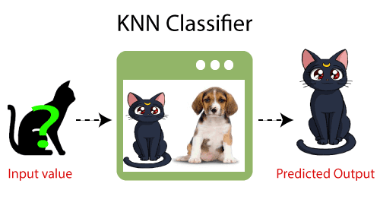
K-Nearest Neighbor(KNN) Algorithm

Slide 11
Why do we need a K-NN Algorithm?
Suppose there are two categories, i.e. Category A and Category B, and we have a new data point x1, so this data point will lie in which of these categories.
To solve this type of problem, we need a K-NN algorithm. With the help of K-NN, we can easily identify the category or class of a particular dataset.
Consider the below diagram:.

Slide 12
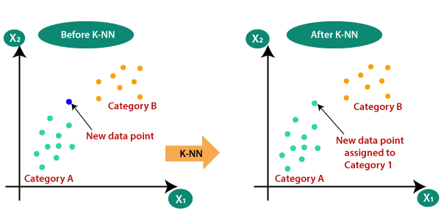

Slide 13
How does K-NN work?
The K-NN working can be explained on the basis of the below algorithm:
Step-1: Select the number K of the neighbors
Step-2: Calculate the Euclidean distance of K number of neighbors
Step-3: Take the K nearest neighbors as per the calculated Euclidean distance.
Step-4: Among these k neighbors, count the number of the data points in each category.
Step-5: Assign the new data points to that category for which the number of the neighbor is maximum.
Step-6: Our model is ready.

Slide 14
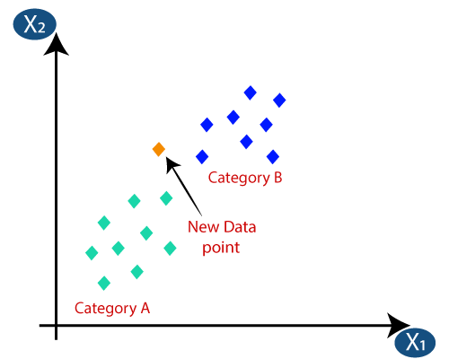
How does K-NN work?
Suppose we have a new data point and we need to put it in the required category. Consider the below image

Slide 15
How does K-NN work?
Firstly, we will choose the number of neighbors, so we will choose the k=5.
Next, we will calculate the Euclidean distance between the data points.
The Euclidean distance is the distance between two points, which we have already studied in geometry. It can be calculated as:

Slide 16
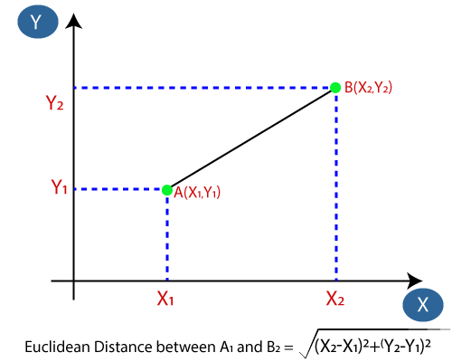

Slide 17
How does K-NN work?
By calculating the Euclidean distance we got the nearest neighbors, as three nearest neighbors in category A and two nearest neighbors in category B. Consider the Given image:
As we can see the 3 nearest neighbors are from category A, hence this new data point must belong to category A.

Slide 18
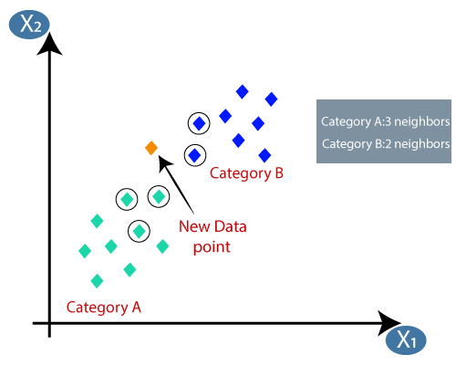

Slide 19
How to select the value of K in the K-NN Algorithm?
Below are some points to remember while selecting the value of K in the K-NN algorithm:
There is no particular way to determine the best value for "K", so we need to try some values to find the best out of them. The most preferred value for K is 5.
A very low value for K such as K=1 or K=2, can be noisy and lead to the effects of outliers in the model.
Large values for K are good, but it may find some difficulties.

Slide 20
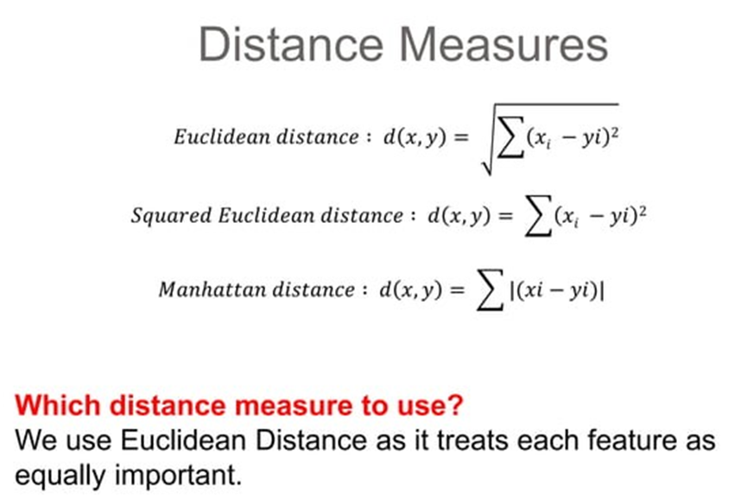
KNN Algorithm Example

Slide 21
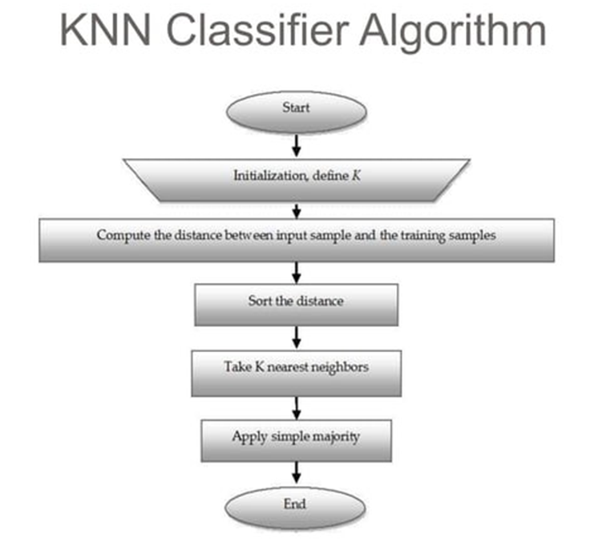
KNN Algorithm

Slide 22
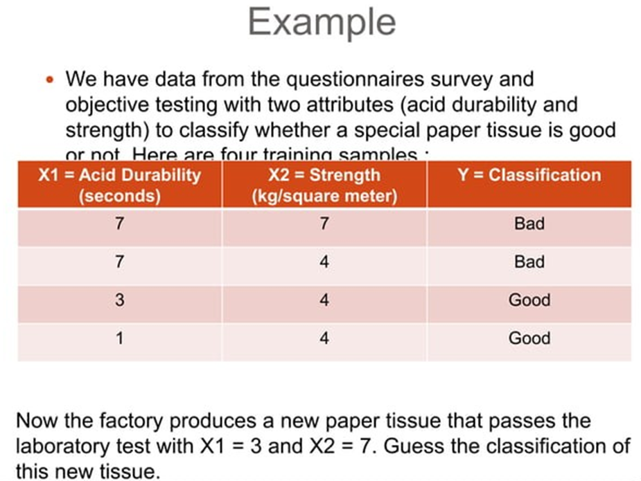
KNN Algorithm Example

Slide 23
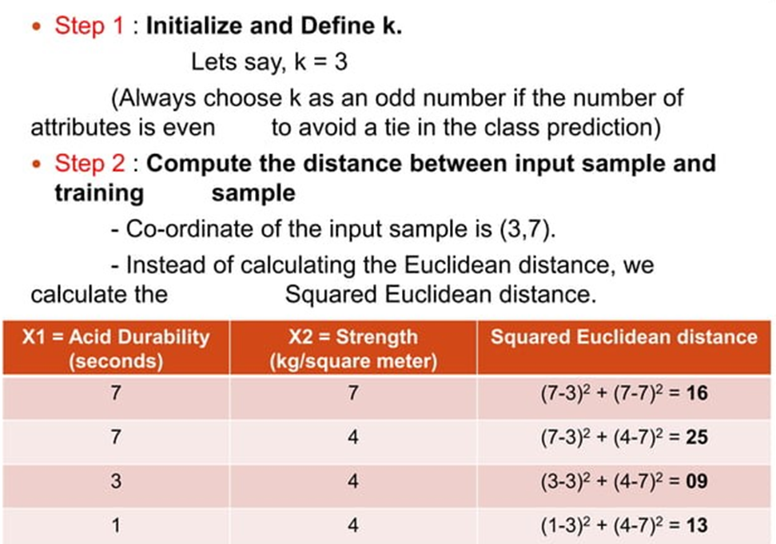

Slide 24
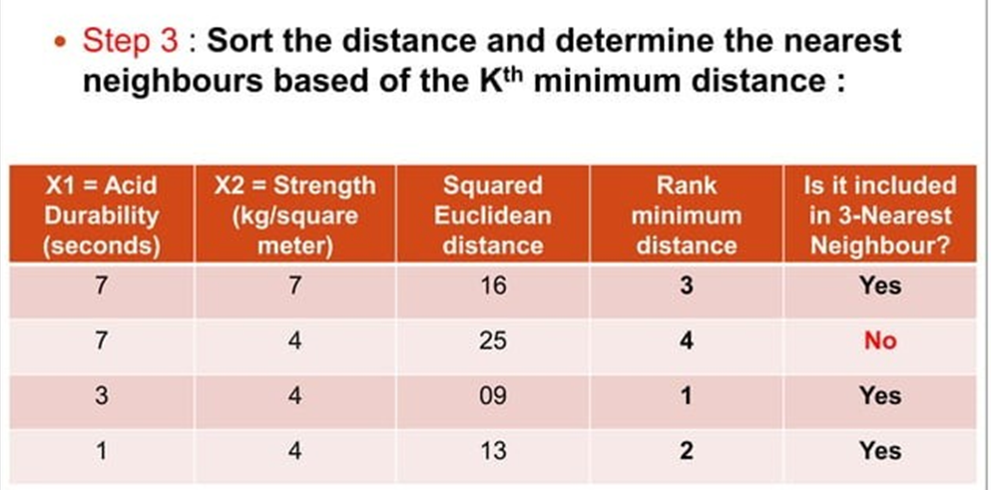

Slide 25
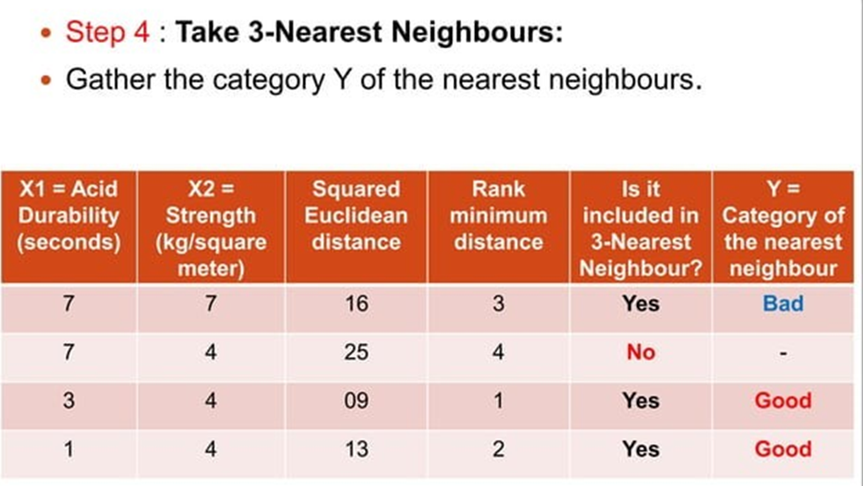

Slide 26
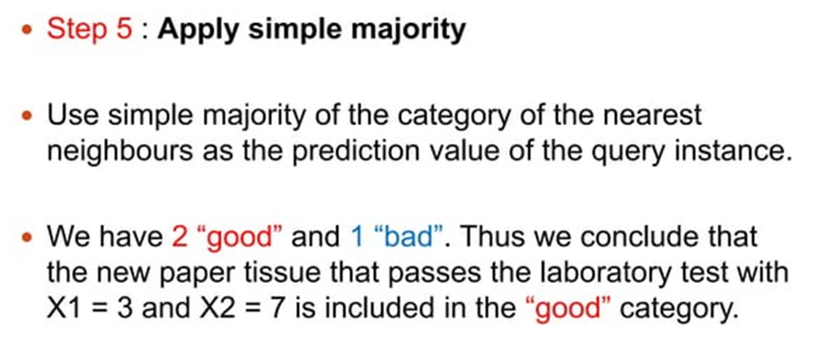

Slide 27
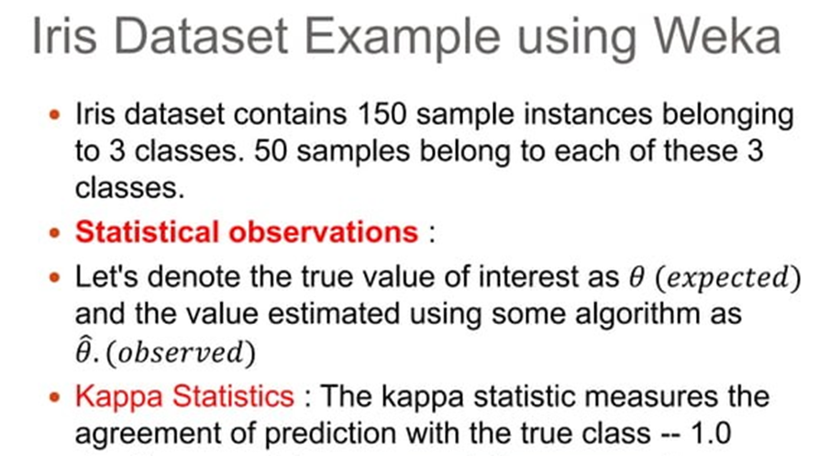

Slide 28
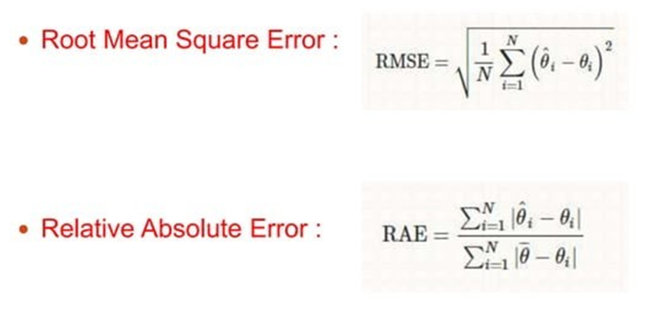

Slide 29
﻿Complexity
Basic KNN algorithm stores all examples
·
Suppose we have n examples each of dimension d
O(d) to compute distance to one examples • O(nd) to computed distances to all examples • Plus O(nk) time to find k closest examples
Total time: O(nk+nd)
Very expensive for a large number of samples • But we need a large number of samples for kNN to to work well!!

Slide 30
Advantages of KNN Algorithm:
It is simple to implement.
It is robust to the noisy training data
It can be more effective if the training data is large.
Disadvantages of KNN Algorithm:
Always needs to determine the value of K which may be complex some time.
The computation cost is high because of calculating the distance between the data points for all the training samples..

Slide 31
﻿Applications of KNN Classifier
Used in classification
Used to get missing values
Used in pattern recognition
Used in gene expression
Used in protein-protein prediction
Used to get 3D structure of protein
Used to measure document similarity

Slide 32
Conclusion
﻿
KNN is what we call lazy learning (vs. eager learning)
Conceptually simple, easy to understand and explain
Very flexible decision boundaries
Not much learning at all!
It can be hard to find a good distance measure
Irrelevant features and noise can be very detrimental
Typically can not handle more than a few dozen attributes
Computational cost: requires a lot computation

Slide 33
KNN Algorithm Example
https://www.vtupulse.com/machine-learning/knn-solved-example-diabetic-patient/
https://www.freecodecamp.org/news/k-nearest-neighbors-algorithm-classifiers-and-model-example/

Slide 34
Logistic Regression
Logistic regression is one of the most popular Machine Learning algorithms, which comes under the Supervised Learning technique. It is used for predicting the categorical dependent variable using a given set of independent variables.
Logistic regression predicts the output of a categorical dependent variable. Therefore the outcome must be a categorical or discrete value. It can be either Yes or No, 0 or 1, true or False, etc. but instead of giving the exact value as 0 and 1, it gives the probabilistic values which lie between 0 and 1.
Logistic Regression is much similar to the Linear Regression except that how they are used. Linear Regression is used for solving Regression problems, whereas Logistic regression is used for solving the classification problems.

Slide 35
Logistic Regression
In Logistic regression, instead of fitting a regression line, we fit an "S" shaped logistic function, which predicts two maximum values (0 or 1).
t is based on the concept of regression, but instead of predicting continuous values, it predicts the probability of an instance belonging to a particular class.
Logistic Regression is widely used in various domains, including healthcare, finance, marketing, and social sciences.
It is especially useful when the dependent variable (the variable being predicted) is categorical or binary

Slide 36

Logistic Regression
Logistic Regression can be used to classify the observations using different types of data and can easily determine the most effective variables used for the classification. The below image is showing the logistic function:

Slide 37
Logistic Function (Sigmoid Function)
The logistic function, also known as the sigmoid function, is a key component of logistic regression.
The sigmoid function maps any real-valued number to a value between 0 and 1.
The value of the logistic regression must be between 0 and 1, which cannot go beyond this limit, so it forms a curve like the "S" form. The S-form curve is called the Sigmoid function or the logistic function.
It has an S-shaped curve, which allows it to model the probability of an instance belonging to a specific class.

Slide 38
Logistic Function (Sigmoid Function)
The sigmoid function is defined as follows: f(x) = 1 / (1 + e^(-x)).
Here, x is the input value, and f(x) represents the output value, which lies between 0 and 1.
As x approaches positive infinity, f(x) approaches 1, indicating a higher probability of belonging to the positive class.
Similarly, as x approaches negative infinity, f(x) approaches 0, indicating a lower probability of belonging to the positive class.
The midpoint of the sigmoid function occurs at x = 0, where f(0) = 0.5, indicating an equal probability of belonging to either class.

Slide 39
Decision Boundary in Logistic Regression
In a two-dimensional feature space, the decision boundary is represented by a line that separates the positive and negative instances.
The decision boundary is derived from the sigmoid function output, where the predicted probability is compared to the threshold value.
Instances with predicted probabilities above the threshold are classified as the positive class, and those below the threshold are classified as the negative class.
The decision boundary can be linear or non-linear, depending on the relationship between the input variables and the output probability.

Slide 40
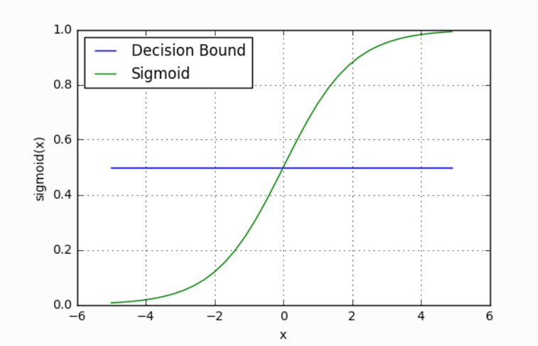
Decision Boundary in Logistic Regression

Slide 41
Decision Boundary in Logistic Regression
Logistic Regression uses a decision boundary to classify instances into different classes based on their predicted probabilities.
The decision boundary is a threshold value that separates the instances.
If the predicted probability is above the threshold, the instance is classified as the positive class; otherwise, it is classified as the negative class.
The decision boundary can be adjusted to control the trade-off between false positives and false negatives

Slide 42
Advantages of Logistic Regression
Logistic Regression is computationally efficient and can handle large datasets.
It provides interpretable results by estimating the impact of each input variable on the output probability.
Logistic Regression can handle both categorical and continuous input variables.
It is robust to noise and outliers in the data.

Slide 43
Limitations of Logistic Regression
L
Logistic Regression assumes a linear relationship between the input variables and the log-odds of the output probability.
It may not perform well if the classes are not linearly separable.
It is sensitive to irrelevant or correlated features.
Logistic Regression is not suitable for multi-class classification without modifications..

Slide 44
Real-world Use Cases of Logistic Regression
L
Predicting customer churn in a telecommunications company based on customer demographics and usage patterns.
Medical diagnosis, such as predicting the likelihood of a patient having a certain disease based on symptoms and test results.
Credit scoring, determining the probability of default for loan applicants based on their financial information.
Spam email classification based on the content and metadata of emails.
Sentiment analysis, classifying the sentiment of customer reviews as positive or negativ..

Slide 45
Type of Logistic Regression:
On the basis of the categories, Logistic Regression can be classified into three types:
Binomial: In binomial Logistic regression, there can be only two possible types of the dependent variables, such as 0 or 1, Pass or Fail, etc.
Multinomial: In multinomial Logistic regression, there can be 3 or more possible unordered types of the dependent variable, such as "cat", "dogs", or "sheep“
Ordinal: In ordinal Logistic regression, there can be 3 or more possible ordered types of dependent variables, such as "low", "Medium", or "High".

Slide 46
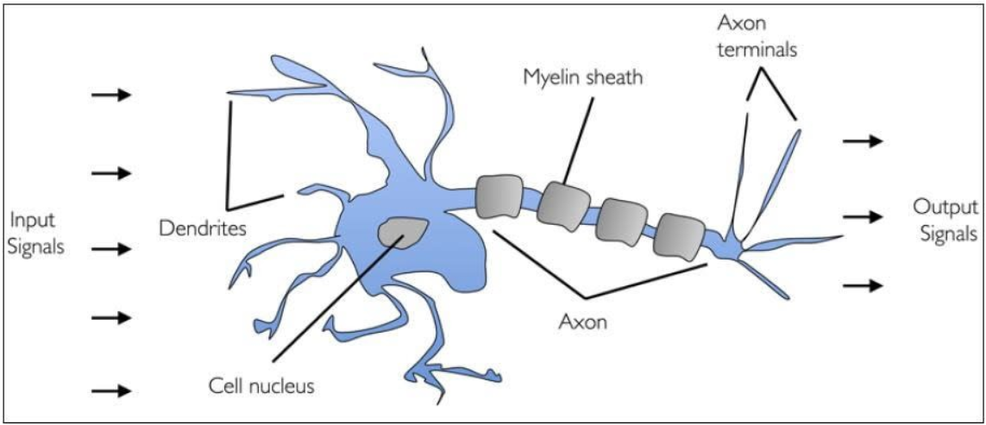
Perceptrons
Biological Neuron

Slide 47
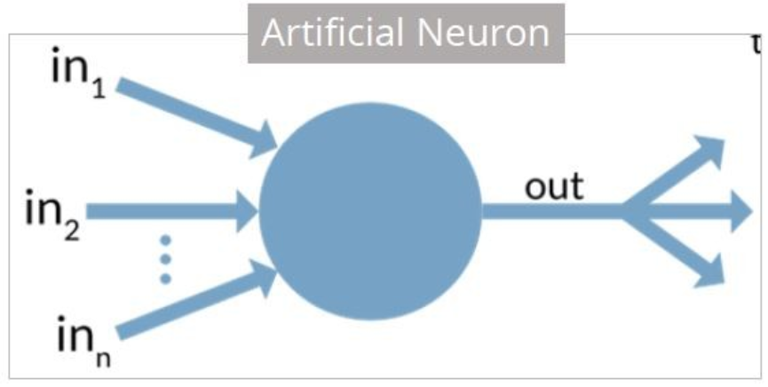
Artificial Neuron
Researchers Warren McCullock and Walter Pitts published their first concept of simplified brain cell in 1943.
This was called McCullock-Pitts (MCP) neuron.
They described such a nerve cell as a simple logic gate with binary outputs. •
Multiple signals arrive at the dendrites and are then integrated into the cell body, and, if the accumulated signal exceeds a certain threshold, an output signal is generated that will be passed on by the axon.

Slide 48
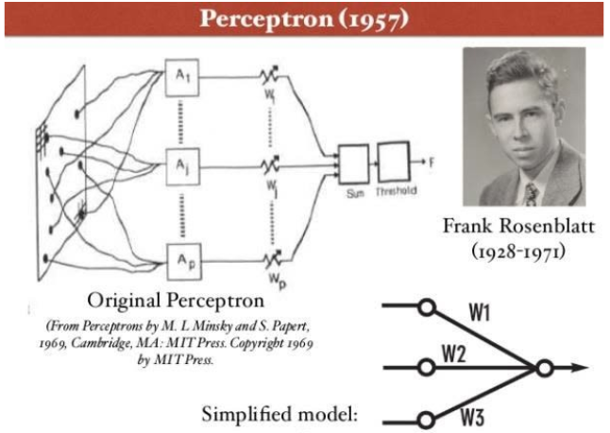
Perceptron
A perceptron is a neural network unit (an artificial neuron) that does certain computations to detect features or business intelligence in the input data.

Slide 49
Perceptron
Perceptron was introduced by Frank Rosenblatt in 1957.
He proposed a Perceptron learning rule based on the original MCP neuron.
A Perceptron is an algorithm for supervised learning of binary classifiers.
This algorithm enables neurons to learn and processes elements in the training set one at a time.

Slide 50
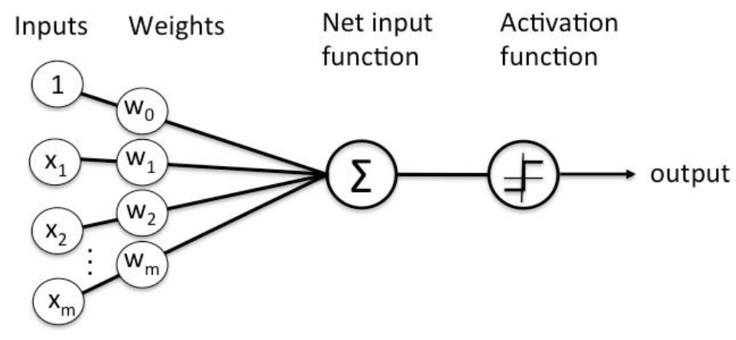
Perceptron

Slide 51
Perceptron
There are two types of Perceptrons
Single layer and Multilayer.
Single layer Perceptrons can learn only linearly separable patterns.
Multilayer Perceptrons or feed forward neural networks with two or more layers have the greater processing power.
The Perceptron algorithm learns the weights for the input signals in order to draw a linear decision boundary.
This enables you to distinguish between the two linearly separable classes +1 and -1. •
Note: Supervised Learning is a type of Machine Learning used to learn models from labeled training data. It enables output prediction for future or unseen data.

Slide 52
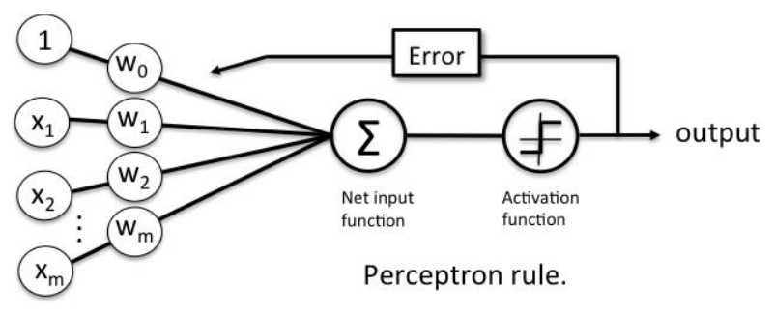
Perceptron Learning Rule
Perceptron Learning Rule states that the algorithm would automatically learn the optimal weight coefficients.
The input features are then multiplied with these weights to determine if a neuron fires or not.

Slide 53
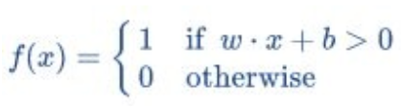
Perceptron function
Perceptron is a function that maps its input “x,” which is multiplied with the learned weight coefficient; an output value ”f(x)”is generated.
In the equation given above:
“w” = vector of real-valued weights
“b” = bias (an element that adjusts the boundary away from origin without any dependence on the input value)
“x” = vector of input x values

Slide 54
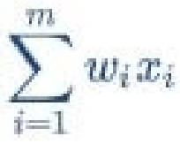
Perceptron function
“m” = number of inputs to the Perceptron
The output can be represented as “1” or “0.” It can also be represented as “1” or “-1” depending on which activation function is used.
Inputs of Perceptron
A Perceptron accepts inputs, moderates them with certain weight values, then applies the transformation function to output the final result.
The above below shows a Perceptron with a Boolean output.

Slide 55
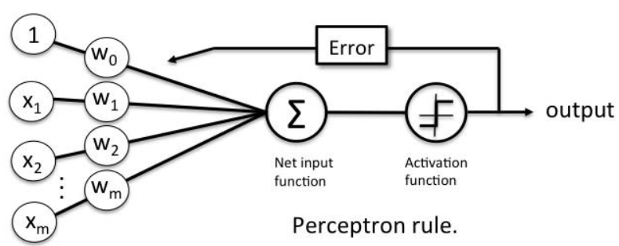
Perceptron function
A Boolean output is based on inputs such as salaried, married, age, past credit profile, etc. It has only two values: Yes and No or True and False.
The summation function “∑” multiplies all inputs of “x” by weights “w” and then adds them up as follows:

Slide 56
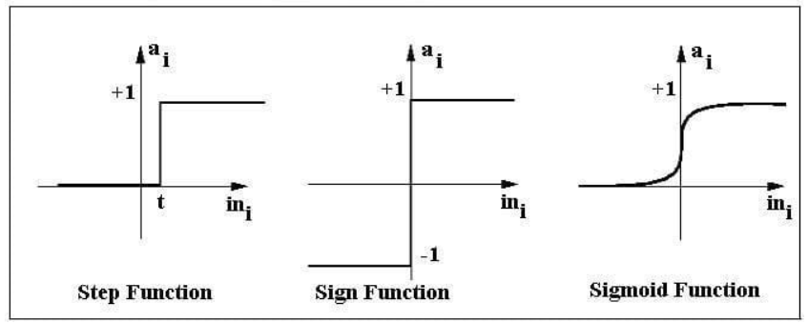
Activation function
The activation function applies a step rule (convert the numerical output into +1 or -1) to check if the output of the weighting function is greater than zero or not

Slide 57
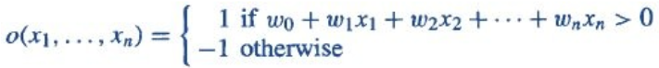
Example
For example: If ∑ wixi> 0 => then final output “o” = 1 (issue bank loan)
Else, final output “o” = -1 (deny bank loan)
Step function gets triggered above a certain value of the neuron output; else it outputs zero. Sign Function outputs +1 or -1 depending on whether neuron output is greater than zero or not. Sigmoid is the S-curve and outputs a value between 0 and 1.
Output of Perceptron
Perceptron with a Boolean output:
Inputs: x1…xn
Output: o(x1….xn)
Weights: wi=> contribution of input xi to the Perceptron output;
w0=> bias or threshold

Slide 58
Support Vector Machines (SVM)
α
Linear Classifiers
x
f
y^{est}
f(x,w,b) = sign(w. x - b)

Slide 59
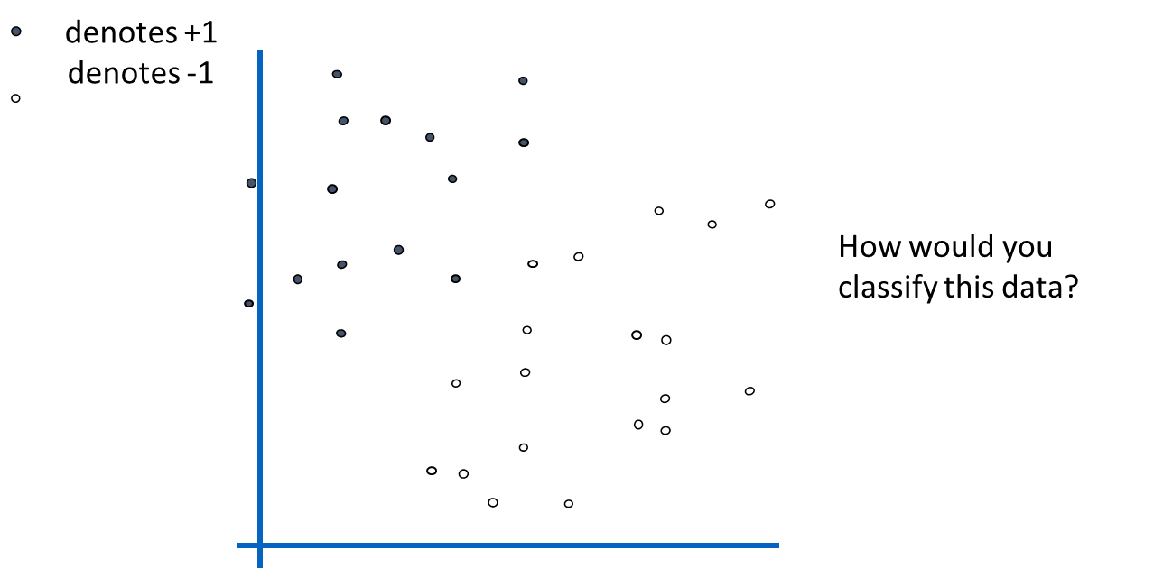

Slide 60
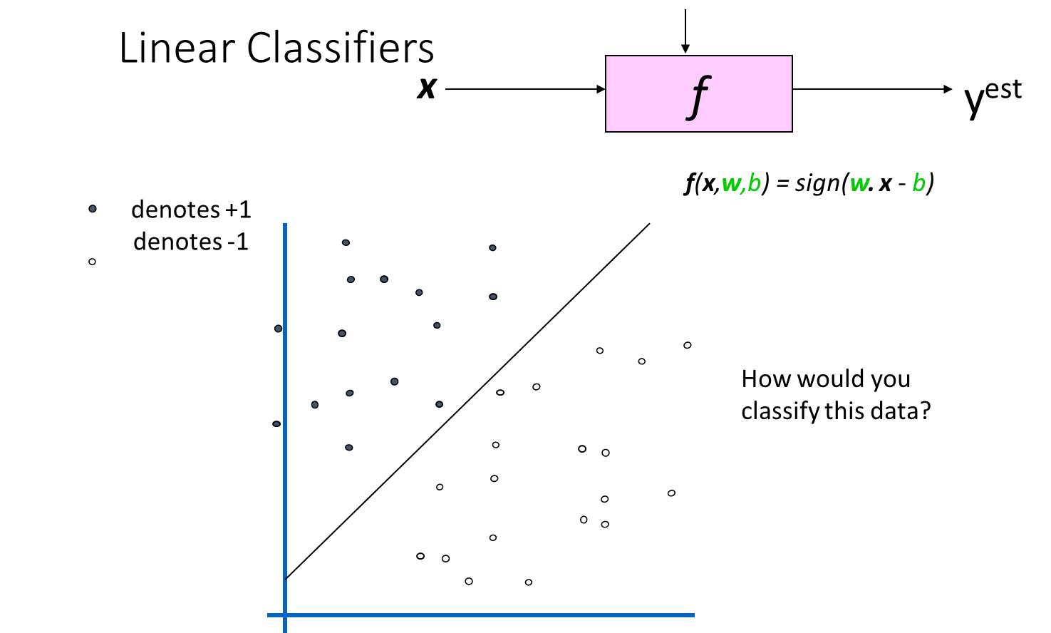

Slide 61


Slide 62


Slide 63


Slide 64
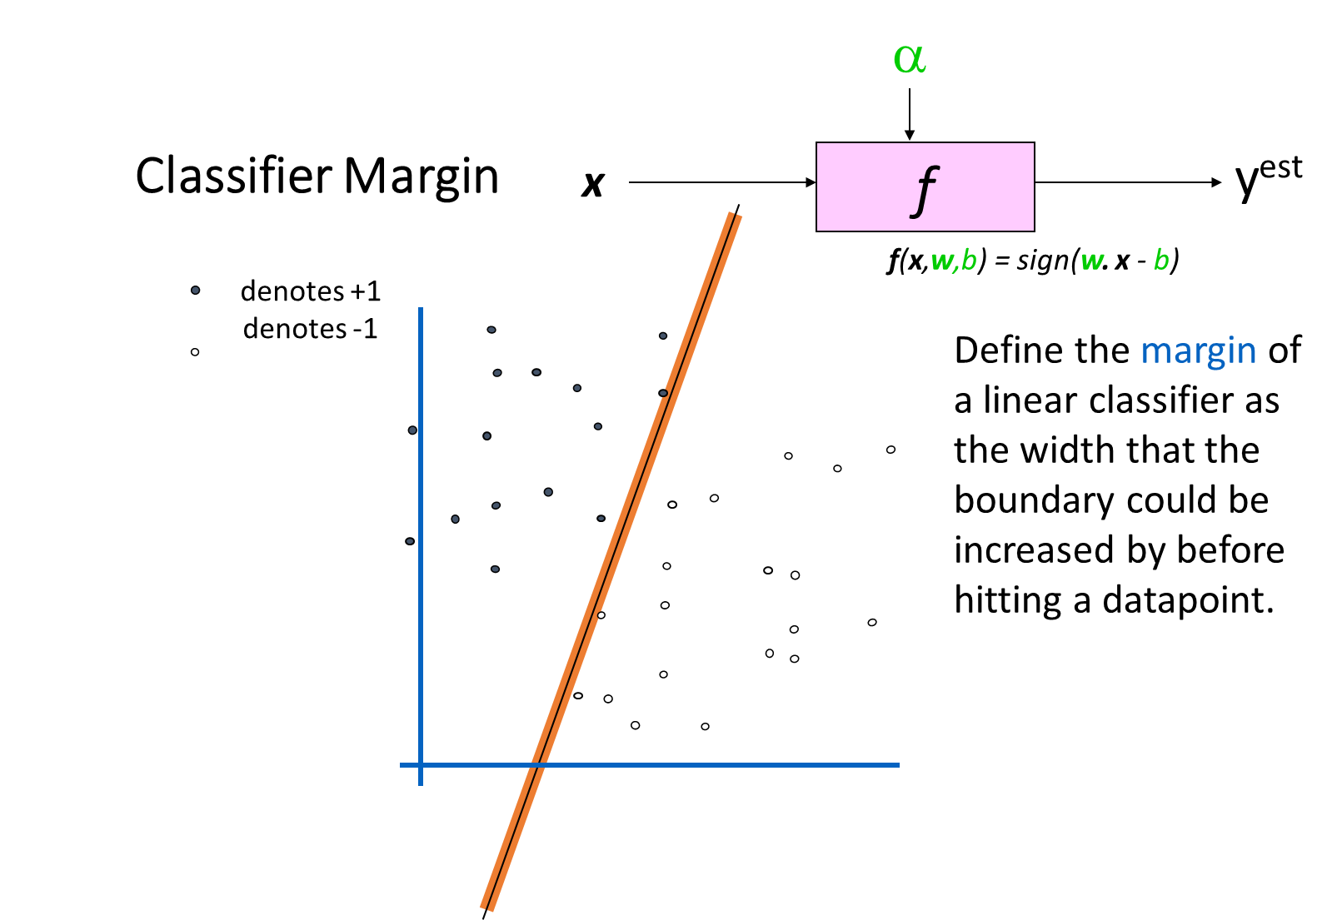

Slide 65
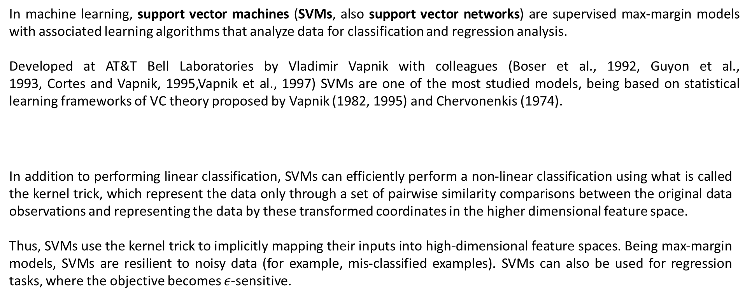

Slide 66
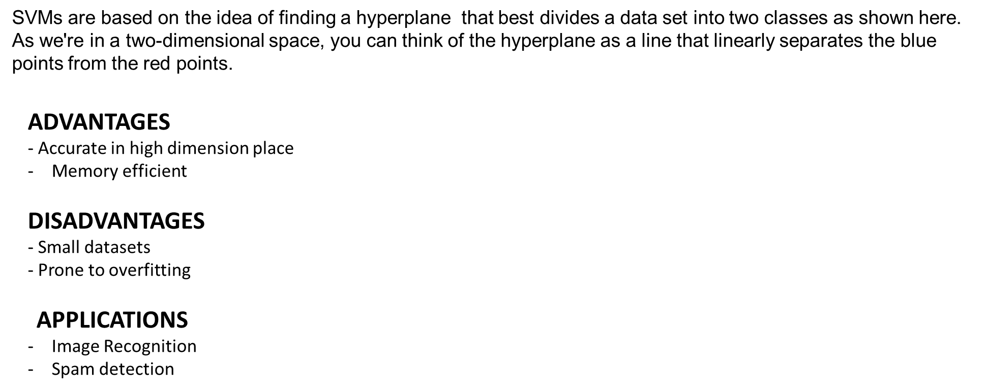

Slide 67
SVMs can be used to solve various real-world problems:
SVMs are helpful in text and hypertext categorization, as their application can significantly reduce the need for labeled training instances in both the standard inductive and transductive settings.
Some methods for shallow semantic parsing are based on support vector machines. Classification of images can also be performed using SVMs.
Experimental results show that SVMs achieve significantly higher search accuracy than traditional query refinement schemes after just three to four rounds of relevance feedback.
This is also true for image segmentation systems, including those using a modified version SVM that uses the privileged approach as suggested by Vapnik.
Classification of satellite data like SAR data using supervised SVM.
Hand-written characters can be recognized using SVM.

Slide 68
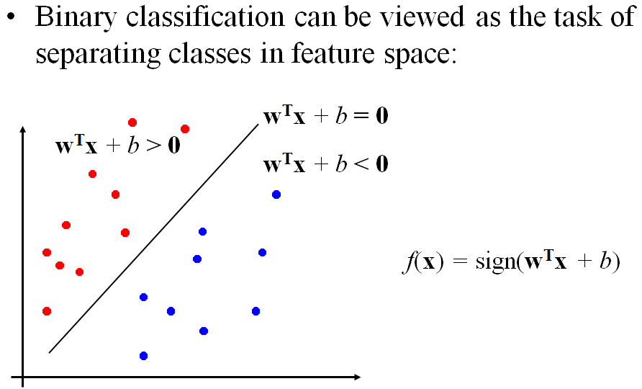
Linear SVM
Perceptron Revisited: Linear Separators

Slide 69
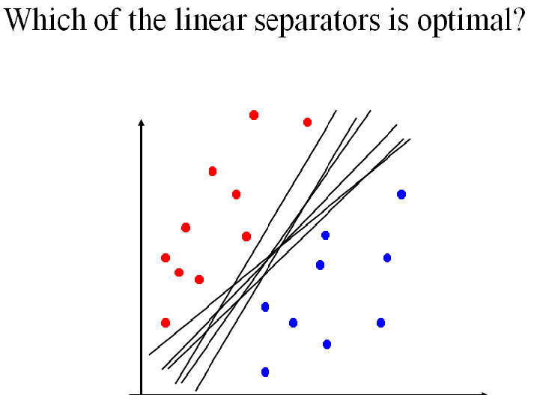
Linear Separators

Slide 70
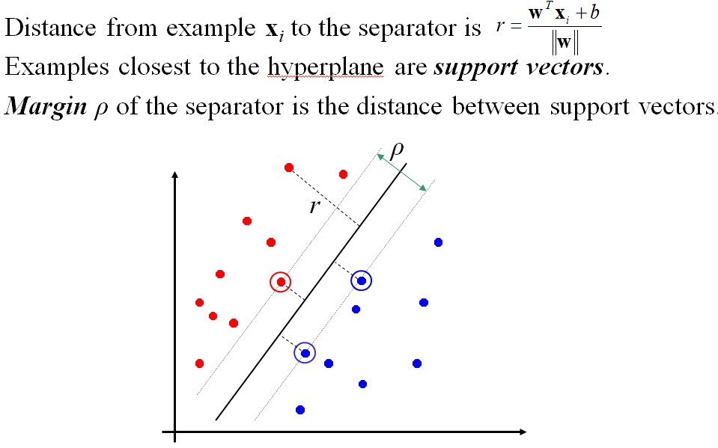
Classification Margin

Slide 71
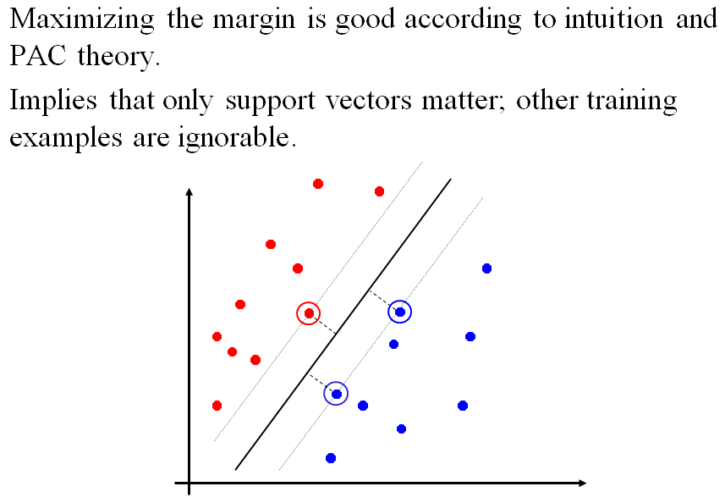
Maximum Margin Classification

Slide 72
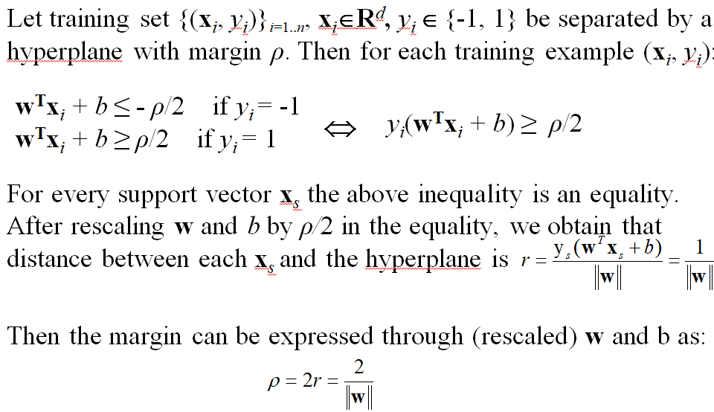
Linear SVM Mathematically

Slide 73
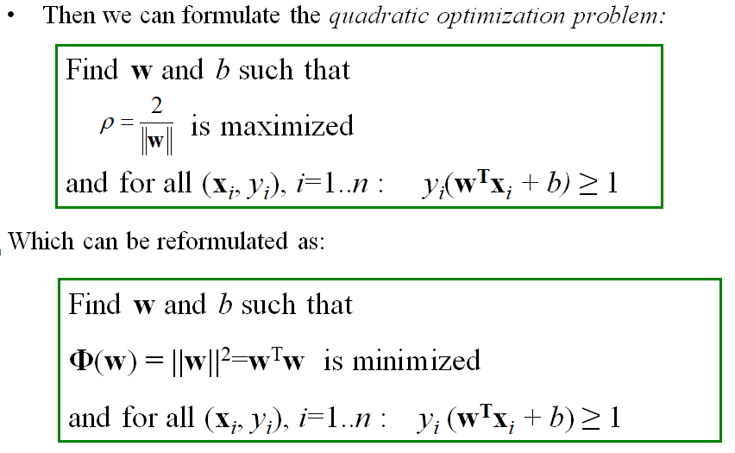
Linear SVMs Mathematically (cont.)

Slide 74
Solving the Optimization Problem
Find w and b such that
Φ(w) =w^{T}w is minimized
and for all (x_{i}, y_{i}), i=1..n : y_{i} (w^{T}x_{i} + b) ≥ 1
Need to optimize a quadratic function subject to linear constraints.
Quadratic optimization problems are a well-known class of mathematical programming problems for which several (non-trivial) algorithms exist.
The solution involves constructing a dual problem where a Lagrange multiplier α_{i} is associated with every inequality constraint in the primal (original) problem:

Slide 75
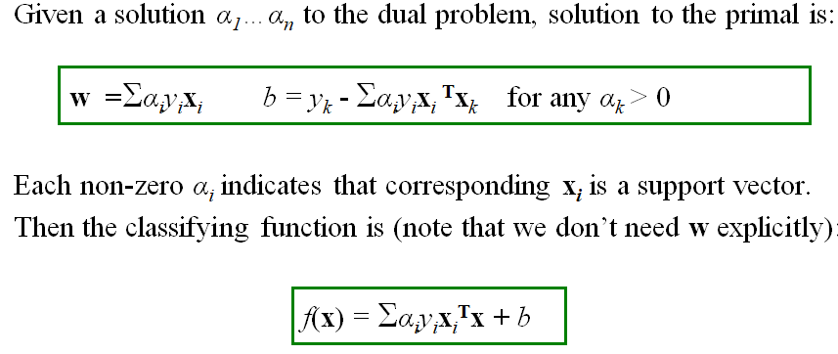
Find α₁…α_{n} such that
Q(α) =Σα_{i} - ½ΣΣα_{i}α_{j}y_{i}y_{j}x_{i}^{T}x_{j} is maximized and
(1) Σα_{i}y_{i} = 0
(2) α_{i} ≥ 0 for all α_{i}
The Optimization Problem Solution

Slide 76
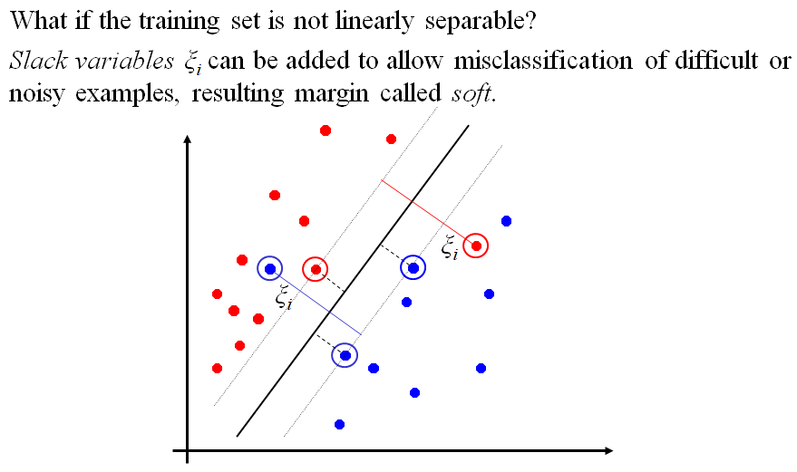
Notice that it relies on an inner product between the test point x and the support vectors x_{i} – we will return to this later.
Also keep in mind that solving the optimization problem involved computing the inner products x_{i}^{T}x_{j} between all training points.
Soft Margin
Classification

Slide 77
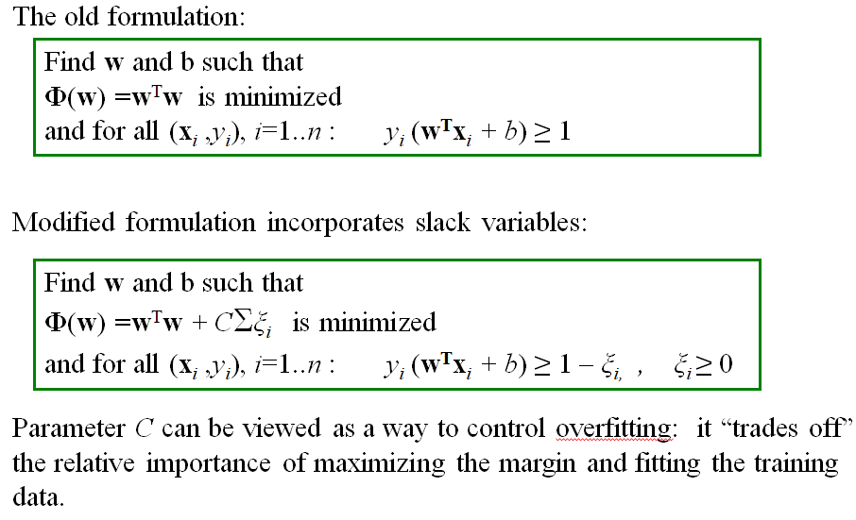
Soft Margin Classification Mathematically

Slide 78
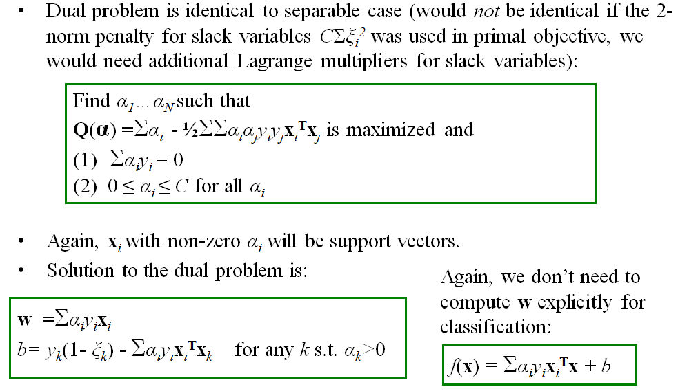
Soft Margin Classification – Solution

Slide 79
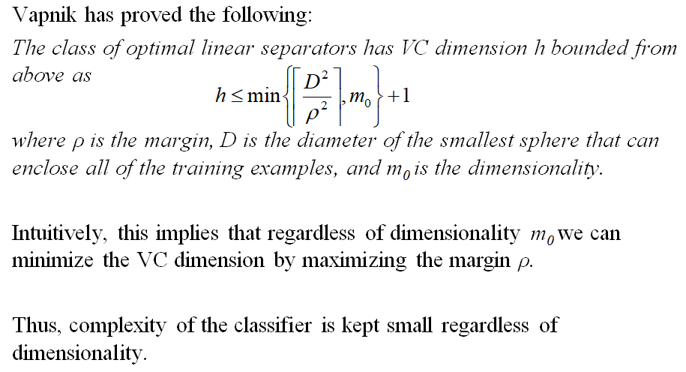
Theoretical Justification for Maximum Margins

Slide 80
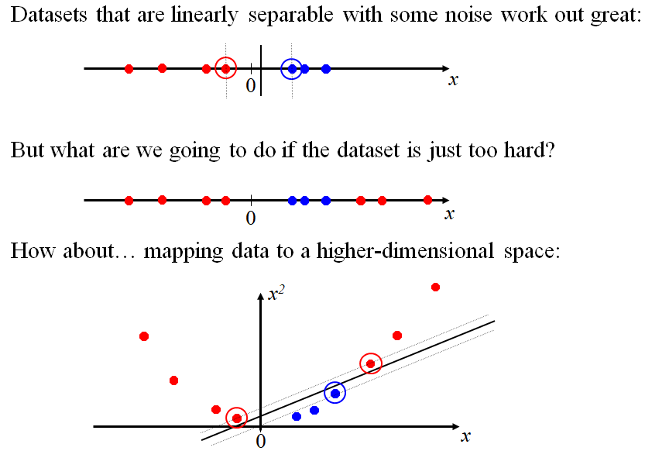
Non-Linear SVM

Slide 81
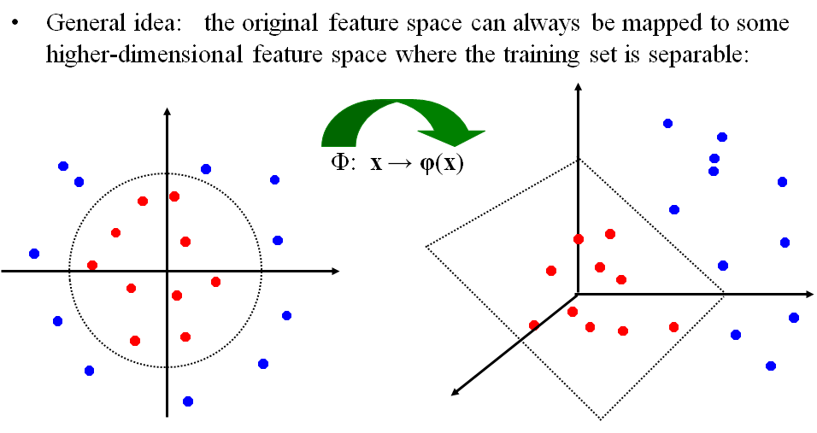
Non-linear SVMs: Feature spaces

Slide 82
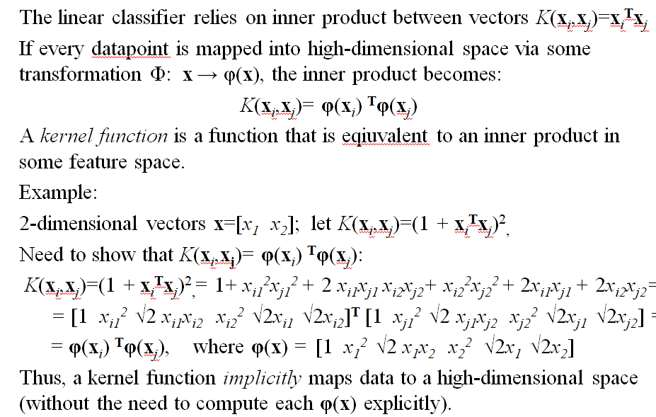
The “Kernel Trick”

Slide 83
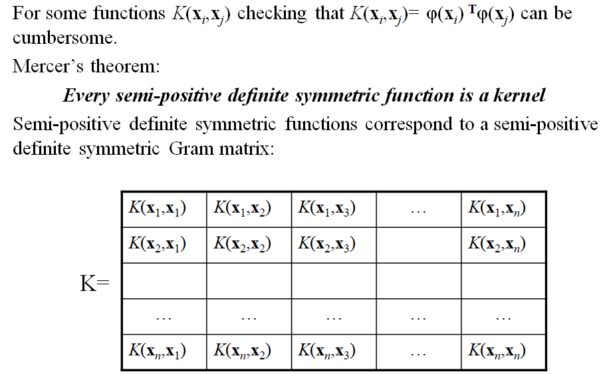
What Functions are Kernels?

Slide 84
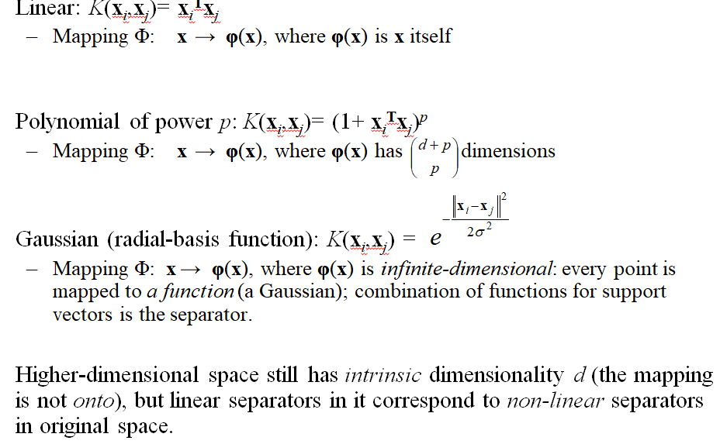
Examples of Kernel Functions

Slide 85
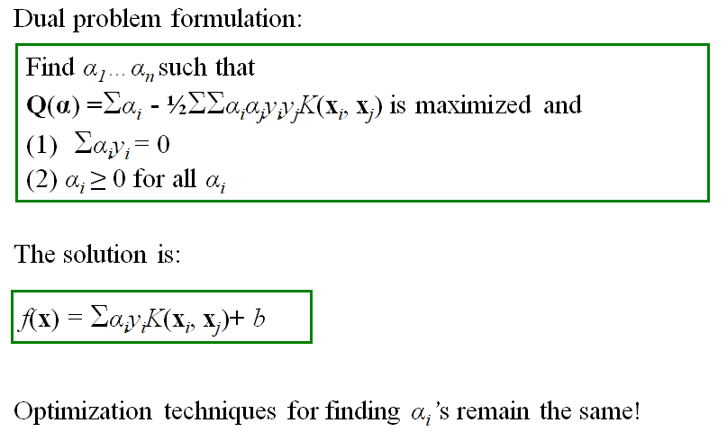
Non-linear SVMs Mathematically

Slide 86
SVM applications
SVMs were originally proposed by Boser, Guyon and Vapnik in 1992 and gained increasing popularity in late 1990s.
SVMs are currently among the best performers for a number of classification tasks ranging from text to genomic data.
SVMs can be applied to complex data types beyond feature vectors (e.g. graphs, sequences, relational data) by designing kernel functions for such data.
SVM techniques have been extended to a number of tasks such as regression [Vapnik et al. ’97], principal component analysis [Schölkopf et al. ’99], etc.
Most popular optimization algorithms for SVMs use decomposition to hill-climb over a subset of α_{i}’s at a time, e.g. SMO [Platt ’99] and [Joachims ’99]
Tuning SVMs remains a black art: selecting a specific kernel and parameters is usually done in a try-and-see manner.

Slide 87
Thank You!!!

Slide 88




www.paruluniversity.ac.in

